Slide 1
Producer Consumer Problem

Slide 2
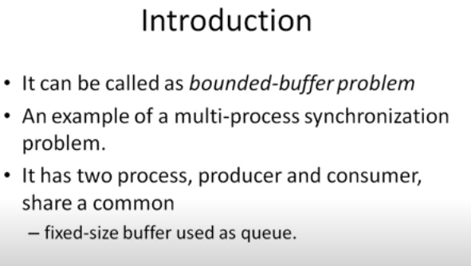
Producer Consumer Problem

Slide 3
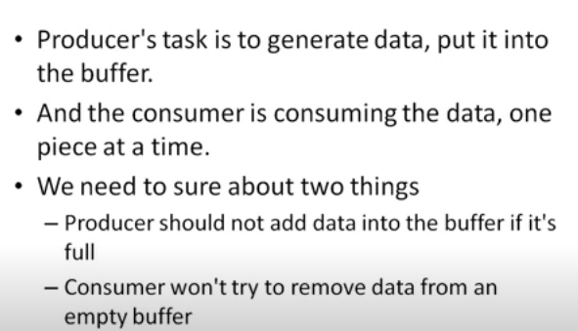

Slide 4
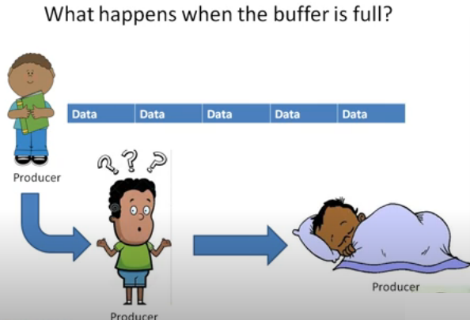

Slide 5
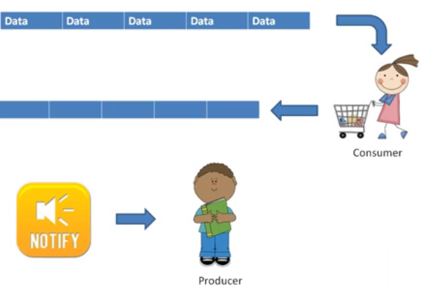
Consume One at a time

Slide 6
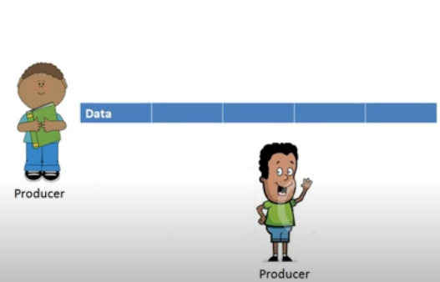
Producer now can add data
Consume One at a time

Slide 7
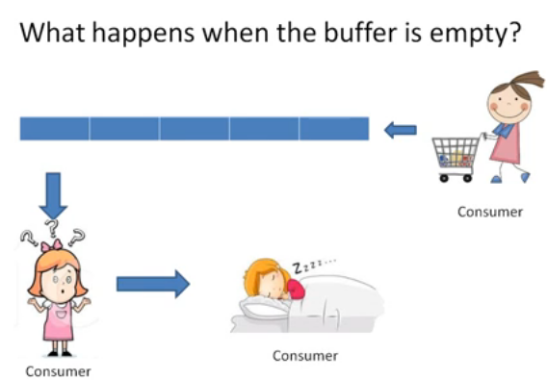

Slide 8
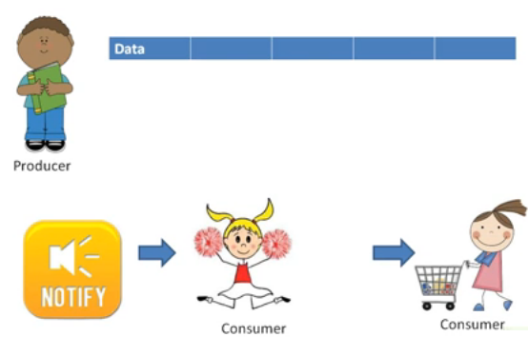

Slide 10
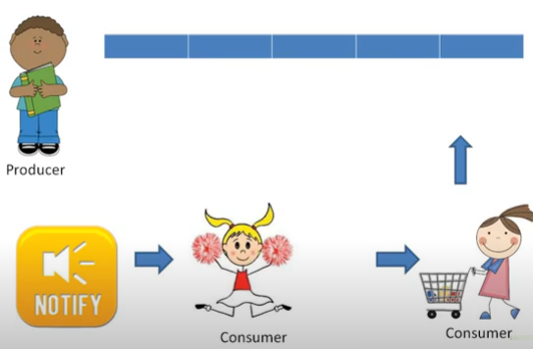

Slide 11
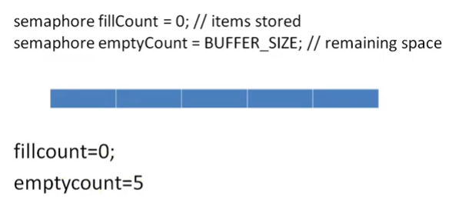

Slide 12
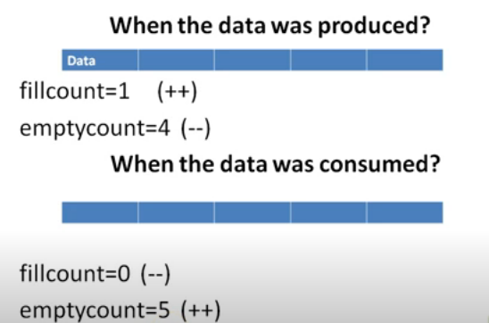

Slide 13
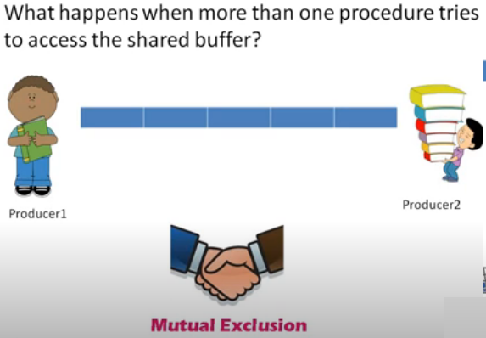

Slide 14
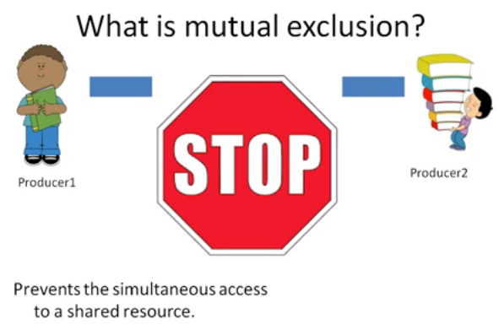

Slide 15



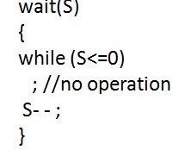
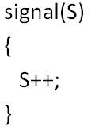
structure of Producer and Consumer using semaphore mechanism
while (true){
wait(mutex);
wait(full);
//remove an item from buffer to nextconsume
signal(empty);
signal(mutex);
}
while (true){
//produce an item & put in nextproduced
wait(mutex);
wait(empty);
//add nextproduced in buffer
signal(full);
signal(mutex);
}

Slide 16
Using condition variables and mutex mechanism
For implementation we have to use one more variable i.e. mutex
here count is shared variable and count = 0 initially, it is shows no. of items in the buffer. in = 0 ,out = 0
while (true){
//locks the buffer ,produce an item & put into nextproduced
while(count == buffer_size);
buffer[in] = nextproduced ;
in= (in + 1) % buffer_size;
count++;
//unlock
}
while (true){
//lock the buffer
while(count == 0);
nextcosumed =buffer[out] ;
out= (out + 1) % buffer_size;
count--;
//consume the item
}

Slide 17


